Slide 1

7.5: Polar Coordinates in $ℝ^{2}$
MATH 1550 - Precalculus

Slide 2



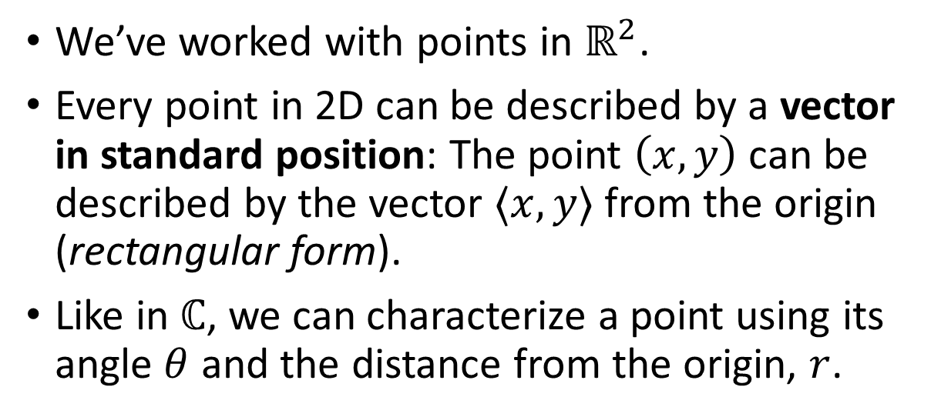



We’ve worked with points in $ℝ^{2}$.
Every point in 2D can be described by a vector in standard position: The point $\left(x,y\right)$ can be described by the vector $⟨x,y⟩$ from the origin (rectangular form).
Like in $ℂ$, we can characterize a point using its angle $θ$ and the distance from the origin, $r$.
$$(x,y)$$
$$y$$
$$r$$
$$θ$$
$$\left(0,0\right)$$
$$x$$

Slide 3

Ex) Convert each of the following equations from polar to rectangular form.
$r\left(\sin\left(θ\right)+2\cos\left(θ\right)\right)=1$
$r^{2}\cos^{2}{(θ)}−2r\cos{(θ})+r^{2}\sin^{2}\left(θ\right)=8$

Slide 4

Ex) Convert each of the following equations from rectangular to polar form.
$x=3$
$x^{2}+y^{2}=9$
$x^{2}+y^{2}=3x$

Slide 5
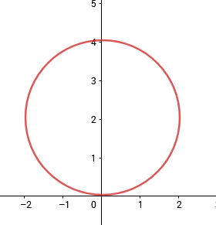
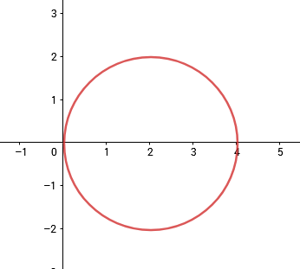
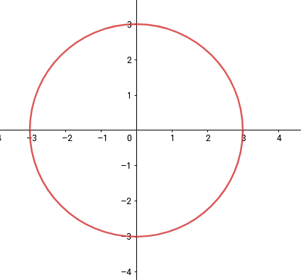
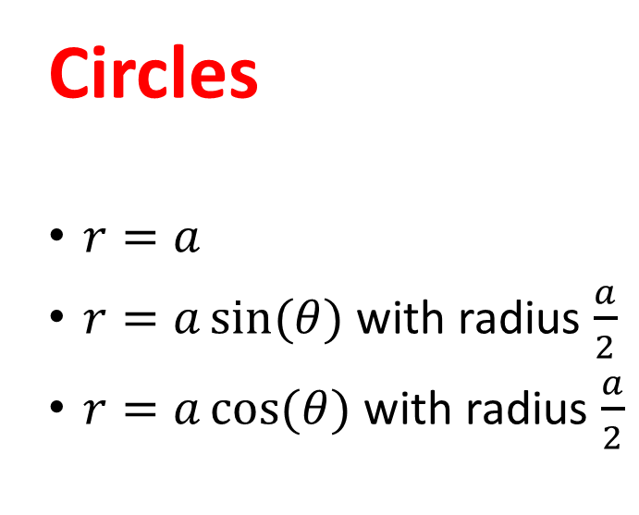
Special Polar Graphs
Circles
$r=a$
$r=a\sin{(θ)}$ with radius $\frac{a}{2}$
$r=a\cos{(θ)}$ with radius $\frac{a}{2}$

Slide 6
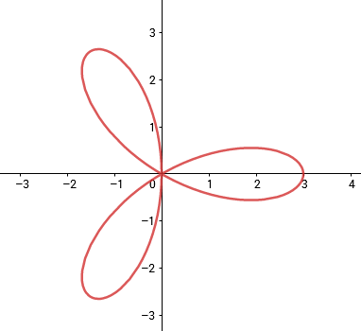
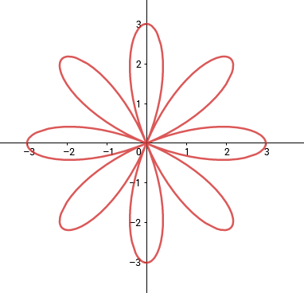

Special Polar Graphs
Rose Curves
$r=a\sin{(nθ)}$
$r=a\cos{(nθ)}$
If $n$ is odd, there are $n$ petals. If $n$ is even, there are 2$n$ petals.

Slide 7
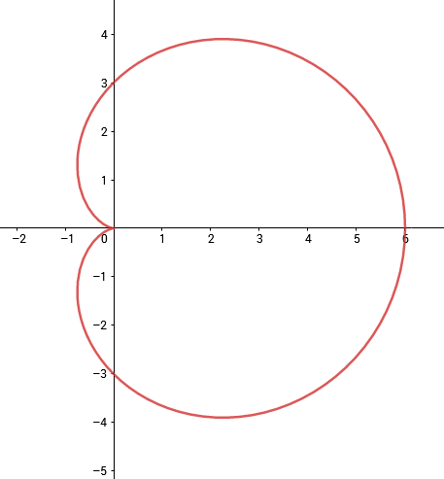
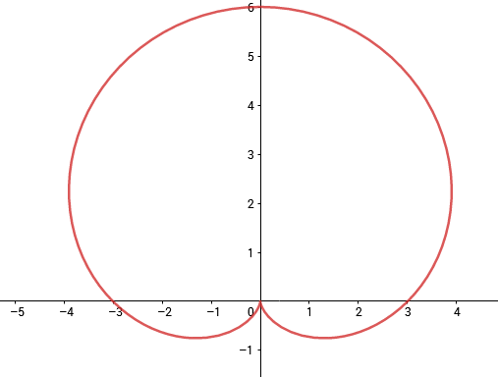
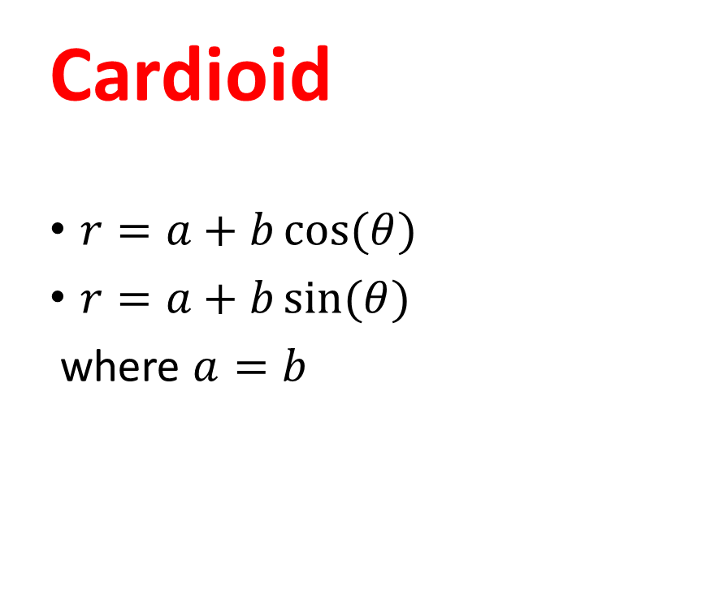
Special Polar Graphs
Cardioid
$r=a+b\cos{(θ)}$
$r=a+b\sin{(θ)}$
where $a=b$

